Slide 1
Pizza Sales Analysis Using MySQL

Slide 2
















HELLO
My name is Pooja Gupta and in this project i have utilize sql queries to solve the question which are related to pizza sales

Slide 3


















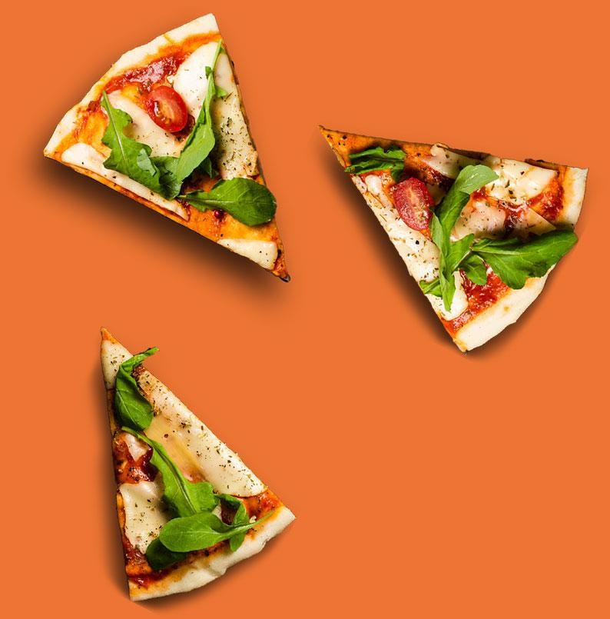




























































































Project Purpose:
The primary objective of this project is to analyze pizza sales data to answer a series of business- related questions. By doing so, we can uncover valuable trends and patterns that can help improve sales strategies and customer satisfaction.

Slide 4






























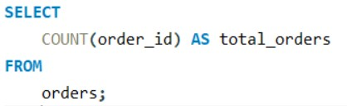































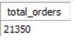


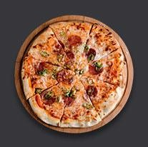
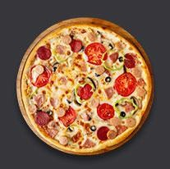





Total Number of Orders
Query
Output

Slide 5











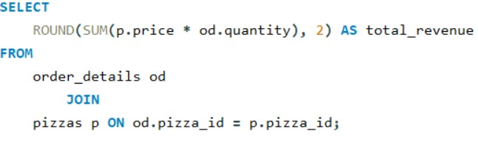


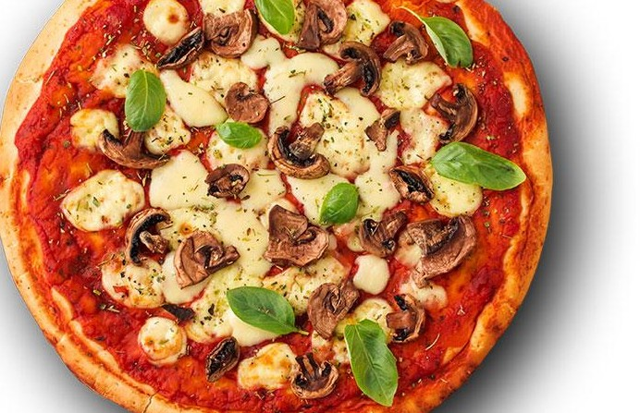
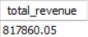

Total Revenue Generated
Query
Output

Slide 6




















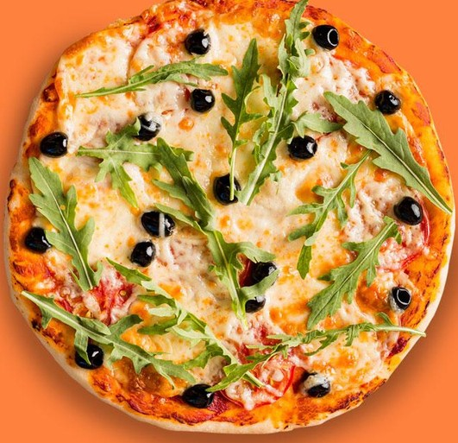






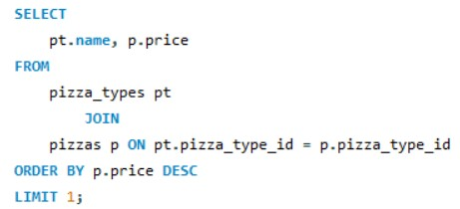












































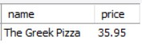










Highest-Priced Pizza
Query
Output

Slide 7

























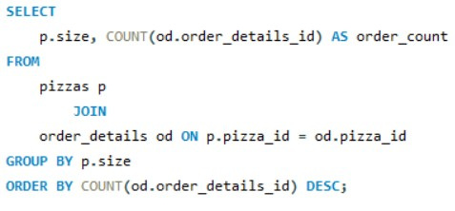
















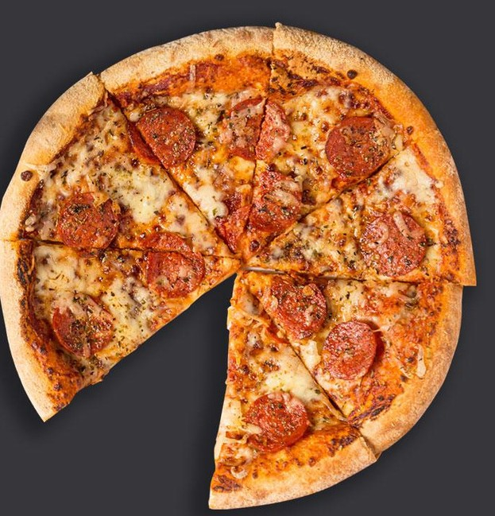




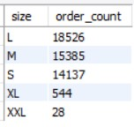








































Most Common Pizza Size
Query
Output

Slide 8























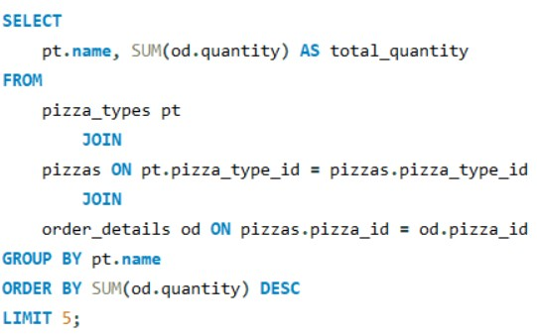












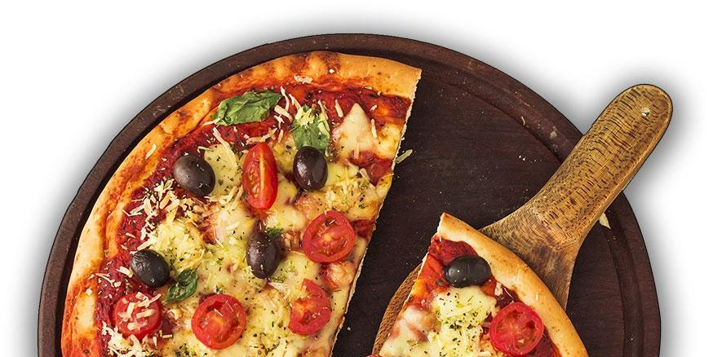














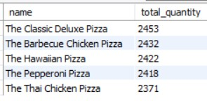



















Top 5 Most Ordered Pizza Types
Query
Output

Slide 9






















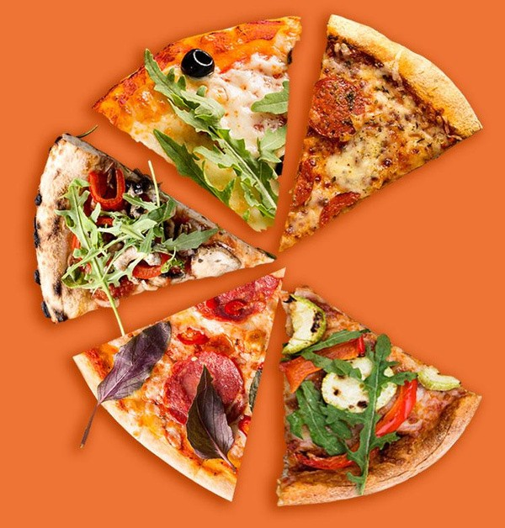

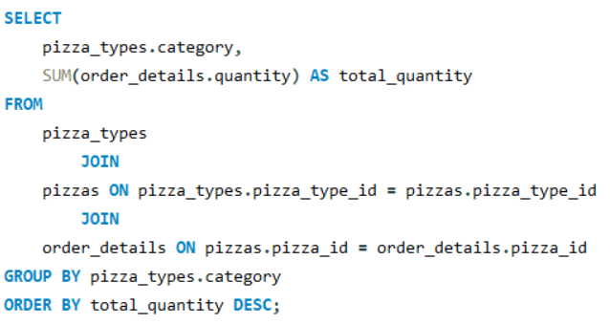

































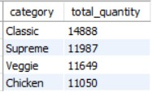











Total Quantity of Each Pizza Category Ordered
Query
Output

Slide 10




















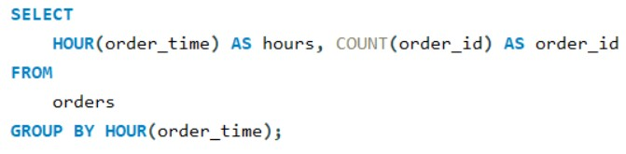


























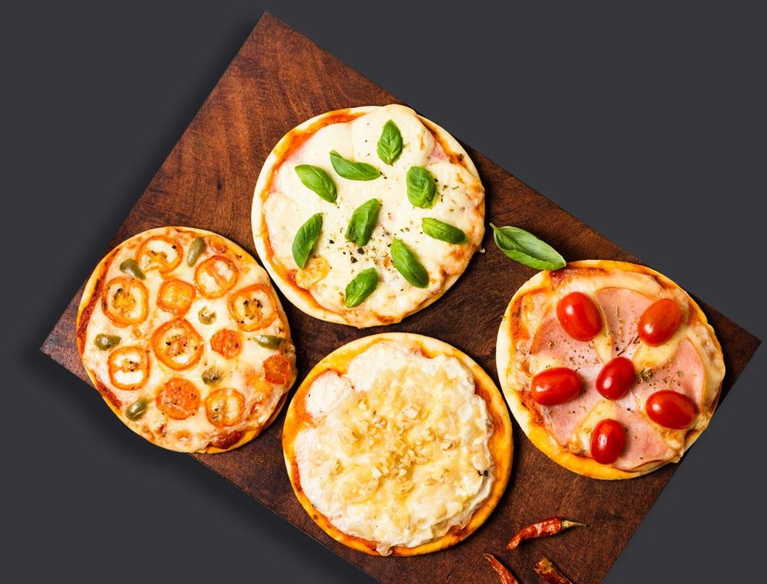
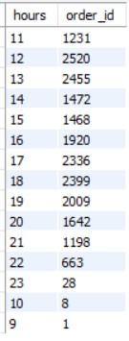






















Distribution of Orders by Hour
Query
Output

Slide 11


















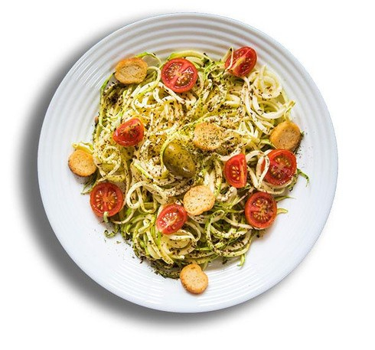











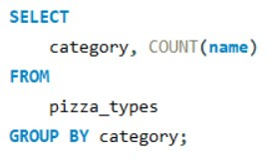





































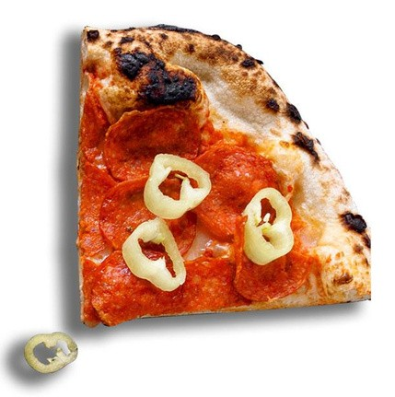
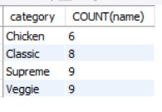




























Category-Wise Distribution of Pizzas
Query
Output

Slide 12














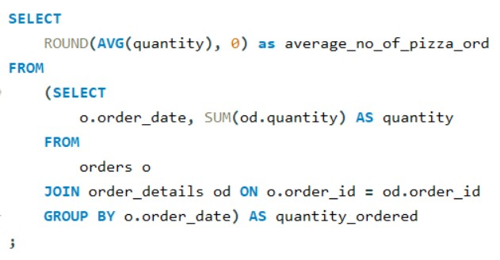



















































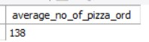




Average Number of Pizzas Ordered per Day
Query
Output

Slide 13














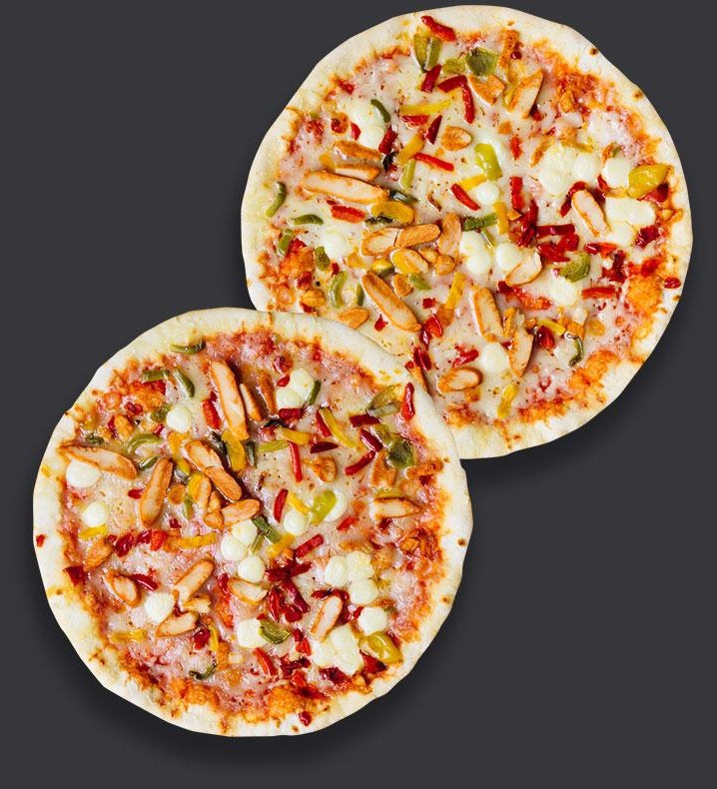





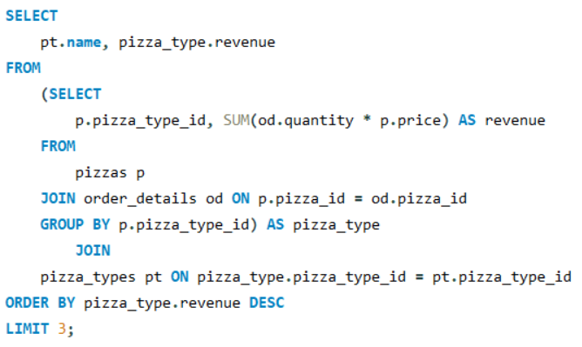



































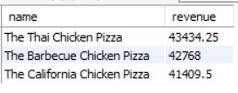















Top 3 Most Ordered Pizza Types by Revenue
Query
$10
Output

Slide 14


















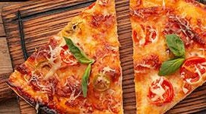

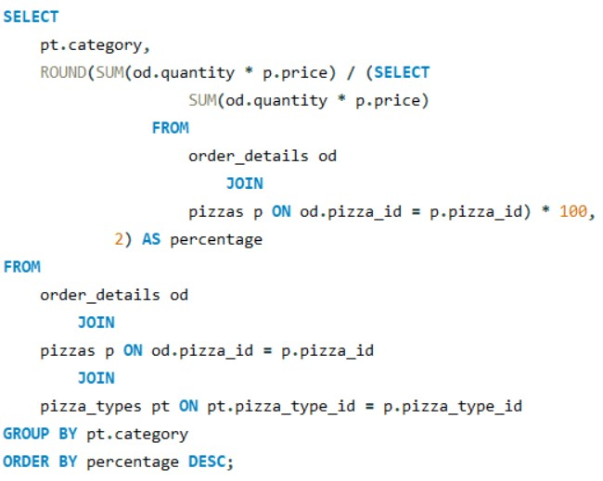
















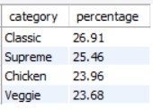





























Percentage Contribution to Total Revenue
Query
Output

Slide 15




















Cumulative Revenue Over Time
Query
Output

Slide 16
Top 3 Most Ordered Pizza Types by Category
Query
Output

Slide 17
Conclusion
Total Sales and Revenue: We processed a total of 21,350 orders, generating a substantial revenue of $817,860.05. Among our menu items, the Greek Pizza stands out as the highest-priced option.
Popular Pizza Sizes and Types: Large pizzas dominate our sales, with 18,526 orders, followed by medium pizzas with 15,385 orders. The top five most ordered pizza types are:
The Classic Deluxe Pizza
The Barbecue Chicken Pizza
The Hawaiian Pizza
The Pepperoni Pizza
The Thai Chicken Pizza
Order Quantities: The Classic Pizza is the most frequently ordered with a total of 14,888 orders. Following it are:
Supreme Pizza: 11,987 orders
Veggie Pizza: 11,649 orders
Chicken Pizza: 11,050 orders
Order Distribution by Hour: Our sales peak during lunchtime, specifically at 12 PM with 2,520 orders and at 1 PM with 2,455 orders, indicating a strong midday demand.
Category Insights: When looking at pizza categories, Supreme and Veggie pizzas are the most popular.
Daily Average and Revenue Contribution: On average, 138 pizzas are ordered per day. The Classic Pizza significantly contributes to our revenue, accounting for 26.91% of the total revenue. The top three most ordered pizzas by revenue are:
The Thai Chicken Pizza: $43,434.25
The Barbecue Chicken Pizza: $42,768.00
The California Chicken Pizza: $41,409.50
Cumulative Revenue Analysis: By tracking cumulative revenue over time, we observed a consistent growth in sales on a day-to-day basis.
Top Categories by Revenue: Additionally, we identified the top three most ordered pizza types by category, which further aids in understanding customer preferences.

Slide 18
Future Recommendations:
Highlight Popular Pizzas: Promote the top-selling pizzas like Classic Deluxe, Barbecue Chicken, and Hawaiian as featured items or in special deals.
Lunch Promotions: Offer lunch specials during peak hours (12 PM and 1 PM) to capitalize on high demand.
Introduce New Varieties: Expand the Supreme and Veggie categories with new flavors to attract more customers.
Large Pizza Discounts: Provide discounts or combo deals on large pizzas, as they are the most commonly ordered size.
Family Deals: Create family and group meal deals to increase the average order value.
Enhanced Online Presence: Optimize your online ordering platform with user-friendly features and exclusive online discounts.
Seasonal : Introduce limited-time seasonal pizzas to keep the menu fresh and exciting.
Health-Conscious Options: Add more health-focused pizzas, such as gluten-free, vegan, or organic options.

Slide 19
ThankYou
I hope this presentation offered meaningful insights into our pizza sales data and demonstrated how data analysis can drive better business decisions

